Slide 1
EE454L Lab4
Mingxi Cheng
mingxic@usc.edu
Oct. 1st 2021

Slide 2
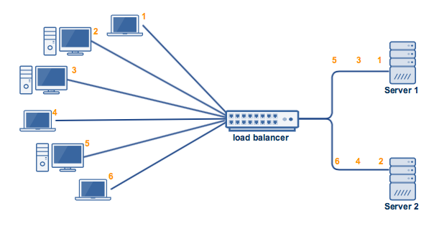
Round Robin (RR)
Each task is assigned in circular order
Tasks: FIFO.
Task 1, Task 2, … , Task 6
VM:
VM 1, VM 2
Time 0: task 1->VM 1
Time 1: task 2->VM 2
Time 2: task 3-> VM 1
Time 3: task 4 -> VM 2

Slide 3
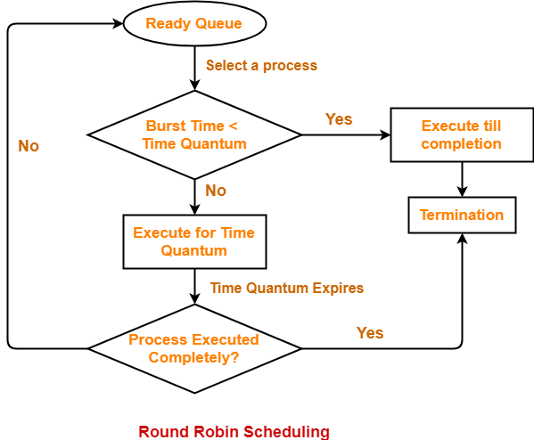
Assumptions & Implementation Choices
We do not release resource on VMs. Meaning that once a task is taken by a VM, it is allowed to run on the machine forever
If a task cannot be assigned to current machine i, try next one, until it is assigned to machine j
For next task, assign to machine i+1 instead of j+1
If a task cannot be assigned after we tried all the machines, put it in a reject queue

Slide 4
Assumptions & Implementation Choices
We do release resource on VMs. Meaning that once a task is taken by a VM, it is allowed to run for a certain amount of time, then it will go back to the queue if not finished
If a task cannot be assigned to current machine i, try next one, until it is assigned to machine j
For next task, assign to machine i+1 instead of j+1
If a task cannot be assigned after we tried all the machines, put it in a reject queue

Slide 5
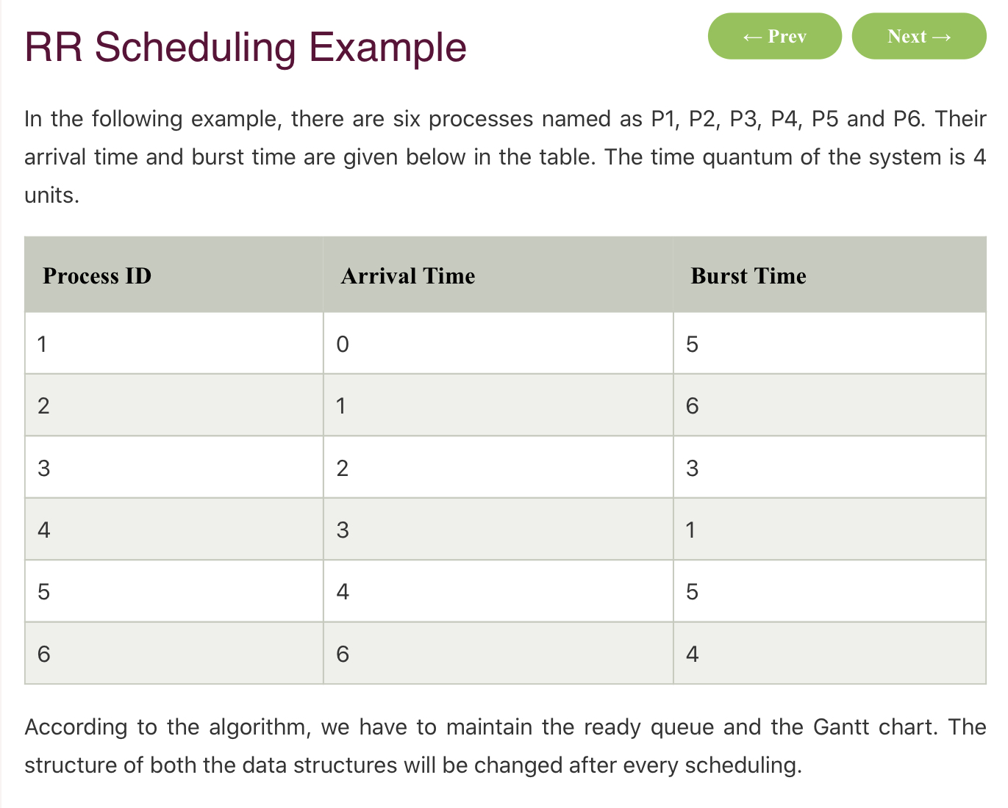
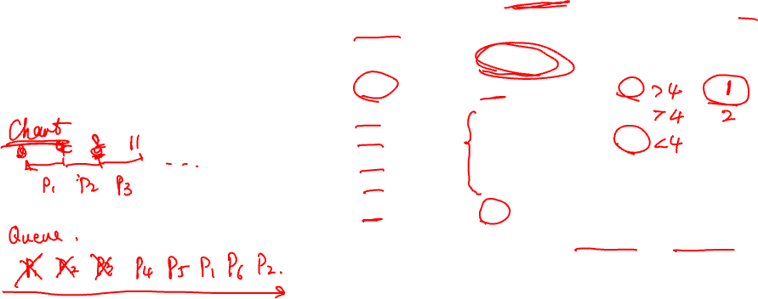
Uniprocessor Example
https://www.javatpoint.com/os-round-robin-scheduling-example

Slide 6
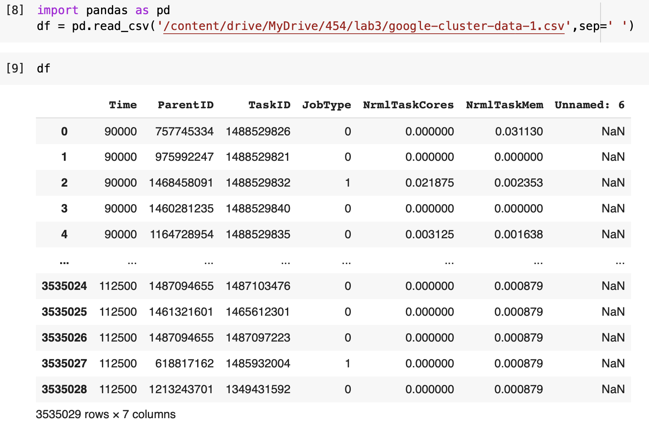
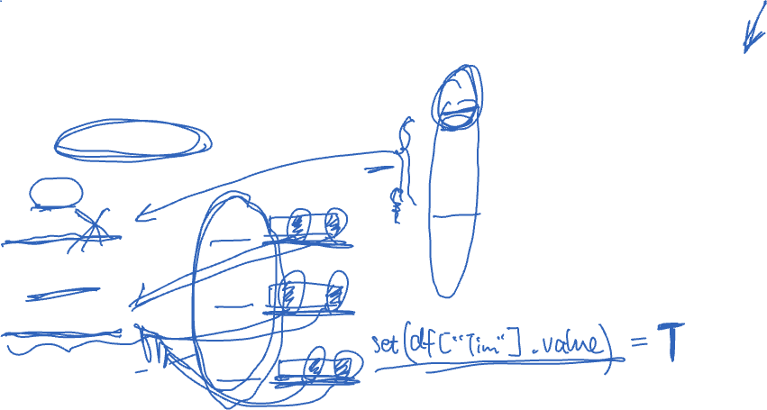
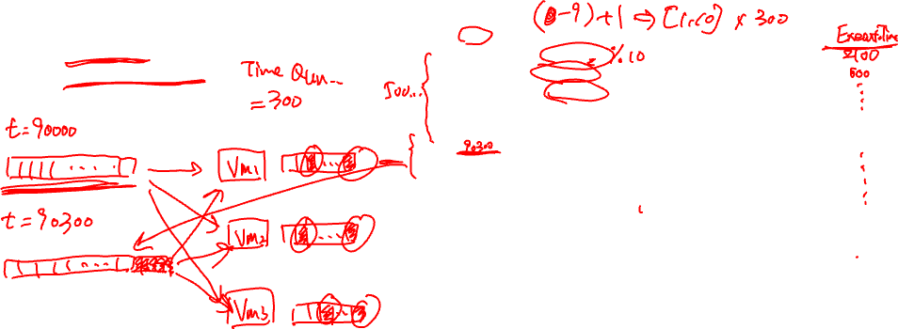
Multi-processor
Burst time: (taskid%10+1)*300
Time quantum 300

Slide 7
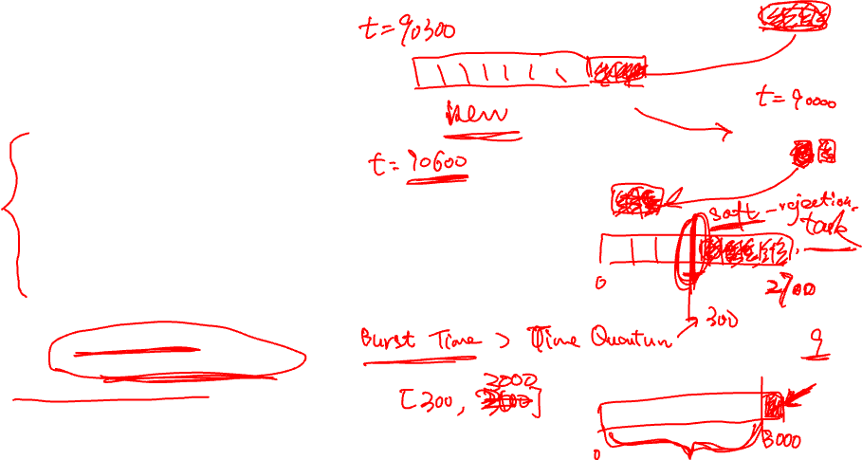
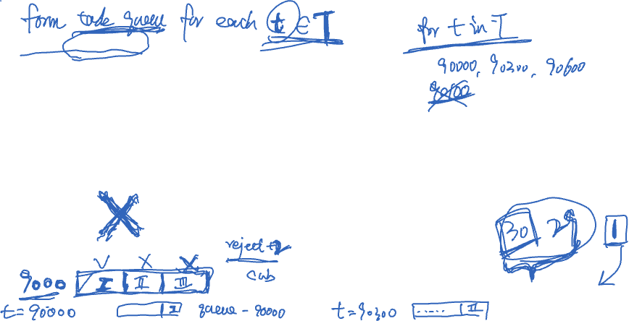
RR Pseudo Code
for i in task queue:
Retrieve cpu_i, mem_i for i
Find current VM id: vm_i
Find vm_i’s resource availability: cpu_vm, mem_vm
if cpu_i <= cpu_vm and mem_i <= mem_vm:
Assign i into vm_i (change cpu and mem availability) for time t
else:
Go to next VM, until we can put task i into it
## stop trying once we looped all VM once
If not possible, reject_queue.append(i)
if not complete
append to task queue
return reject_queue

Slide 8
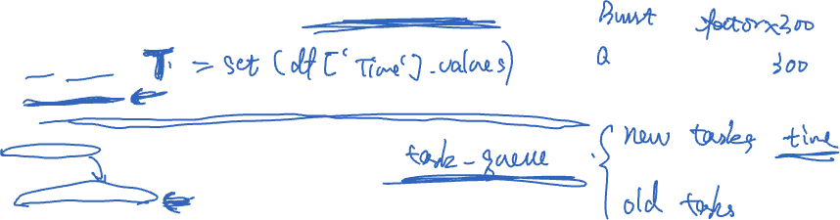
RR Pseudo Code (alternative)
for time in all_time:
Define task queue
## Identify subtasks and construct task queue for current time, and save the rest subtasks into another queue
Run RR
def RR():
Initialize available VMs
for i in task queue:
Retrieve cpu_i, mem_i for i
Find current VM id: vm_i
Find vm_i’s resource availability: cpu_vm, mem_vm
if cpu_i <= cpu_vm and mem_i <= mem_vm:
Assign i into vm_i (change cpu and mem availability) for time t
else:
Go to next VM, until we can put task i into it
## stop trying once we looped all VM once
If not possible, reject_queue.append(i)
return reject_queue

Slide 9
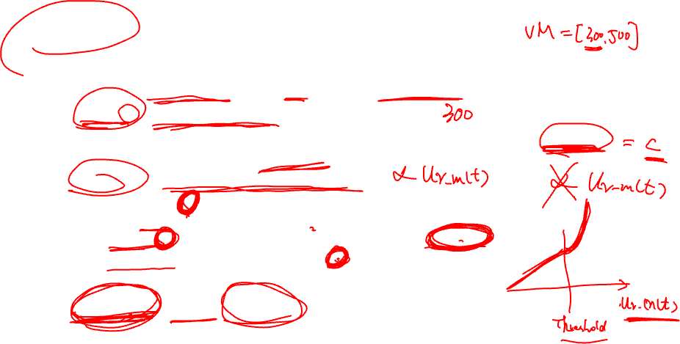
Energy consumption model
Assume for server m at time t, the cpu usage rate is:
Ur_m(t) = total used cpu unit / cpu capacity of m
The power consumption of server m at time t is the sum of static power consumption and dynamic power consumption:
Pwr_m(t) = Pwr_m^st(t)+Pwr_m^dy(t)
Pwr_m^st(t) = c, if Ur_m(t) > 0, Pwr_m^st(t)=0, otherwise
Pwr_m^dy(t) =
Ur_m(t)*a, if Ur_m(t) < threshold
threshold*a + (Ur_m(t)-threshold)^2*b, if Ur_m(t) >= threshold
Total energy consumption:
Pwr_ttl(t) = sum_m Pwr_m(t)

Slide 10
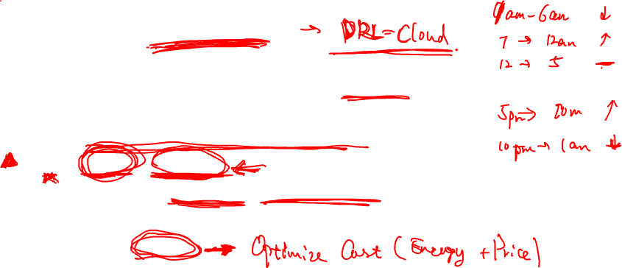
Price model (simplified)
Assume within a day, the electric price id non-flat and depends on the time, e.g., Price(t) for t in [0,24)
Then the real-time pricing (cost) of server m is:
Cost(t) = Price(t) * Pwr_ttl(t)
Total cost of a day is TotalCost = sum_t Cost(t)
Task scheduling: Greedy
Given current time t and utilization rate of all servers on hand, find the best VMs that cost the least for current tasks in queue.

